Slide 1

Data Science Skills ”which are the most valued data science skills”

Slide 2
Contents
Methodology
Demographics
Languages
Databases
Platforms
Web Frames
Development Environments
Operating Systems

Slide 3
Methodology
Datasets
Engineering
link to rmd
Stack Overflow
Amazon.jobs
Monster jobs
LinkedIn 2018
Database
link to create and load db
Discover & Visualize
Presentation
link #1 and link #2
link to deck

Slide 4
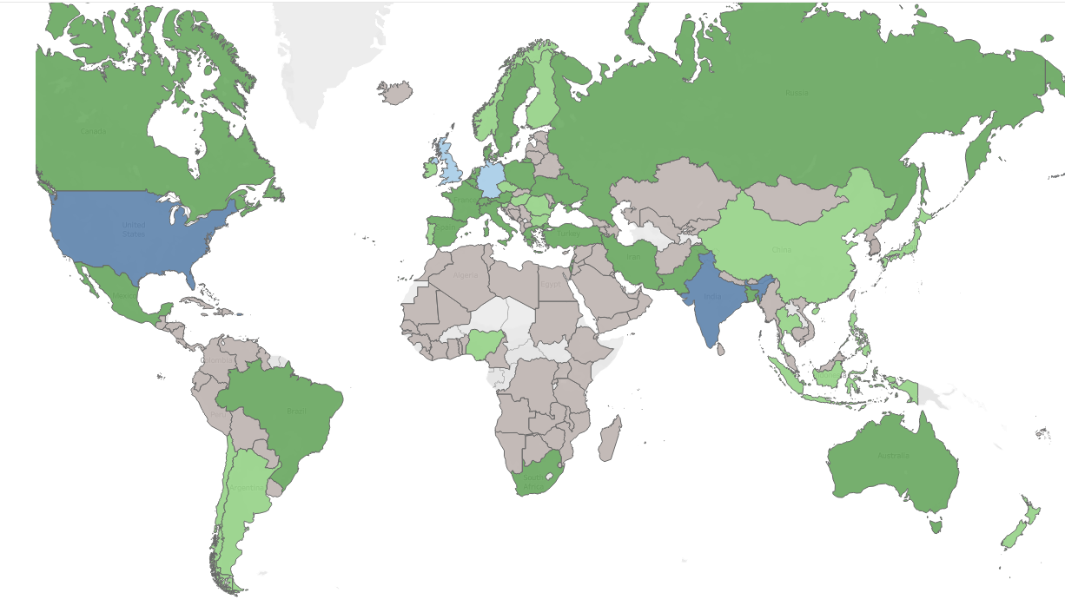
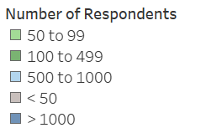
Demographics - Countries
US
India
Turkey,Iran
Pakistan

Slide 5
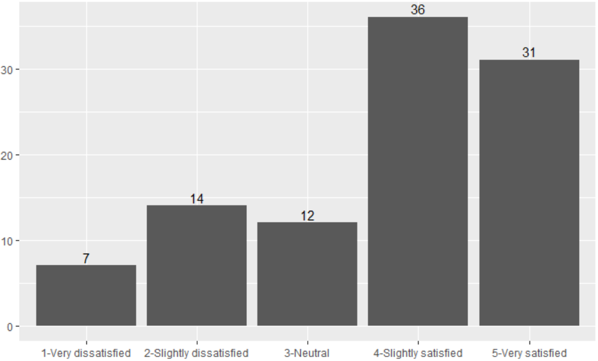
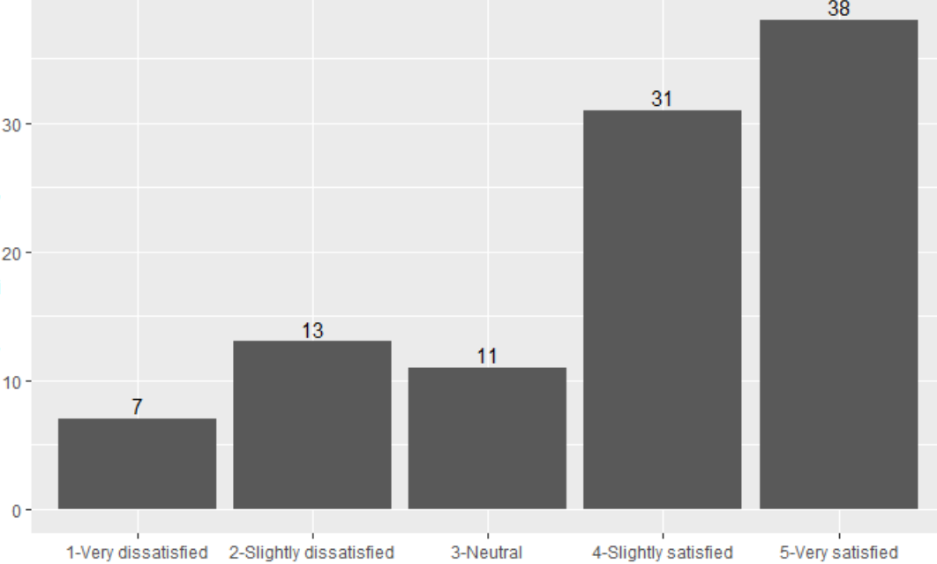
Demographics – Job Satisfaction
Medium response
(countries with 100 – 999 respondents)
High response
(countries with over 1,000 respondents)
Percentage
Satisfaction
Satisfaction

Slide 6
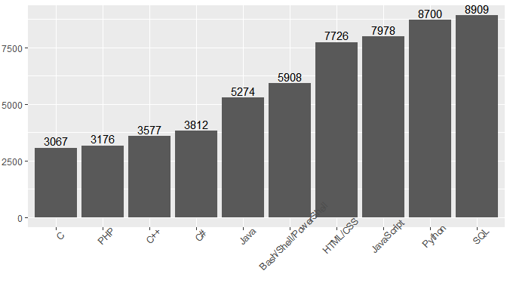
Languages
Most Commonly Used Languages

Slide 7
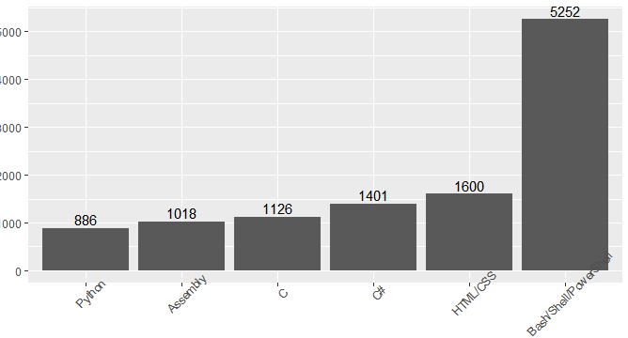
Languages
#1 Preference for Language

Slide 8
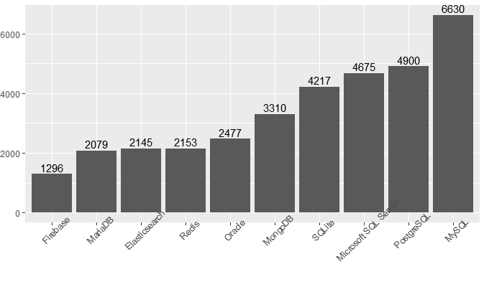
Databases
Most Commonly Used Databases

Slide 9
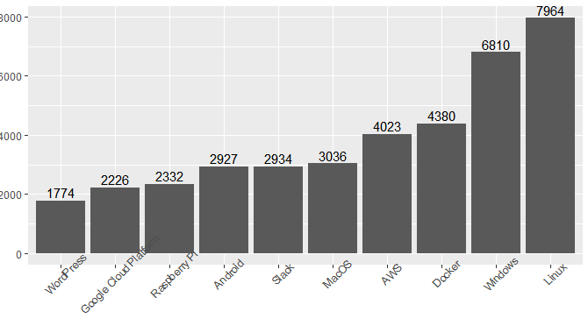
Platforms
Most Commonly Used Platforms

Slide 10
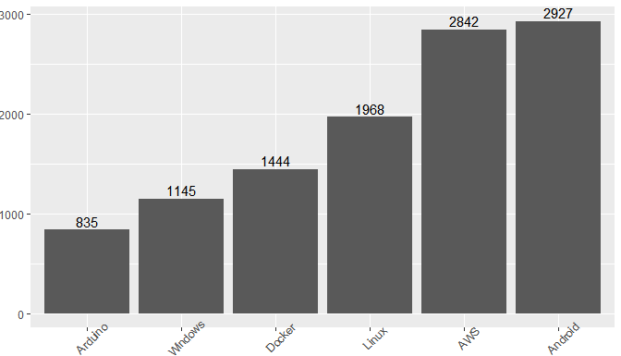
Platforms
#1 Platform by Preference

Slide 11
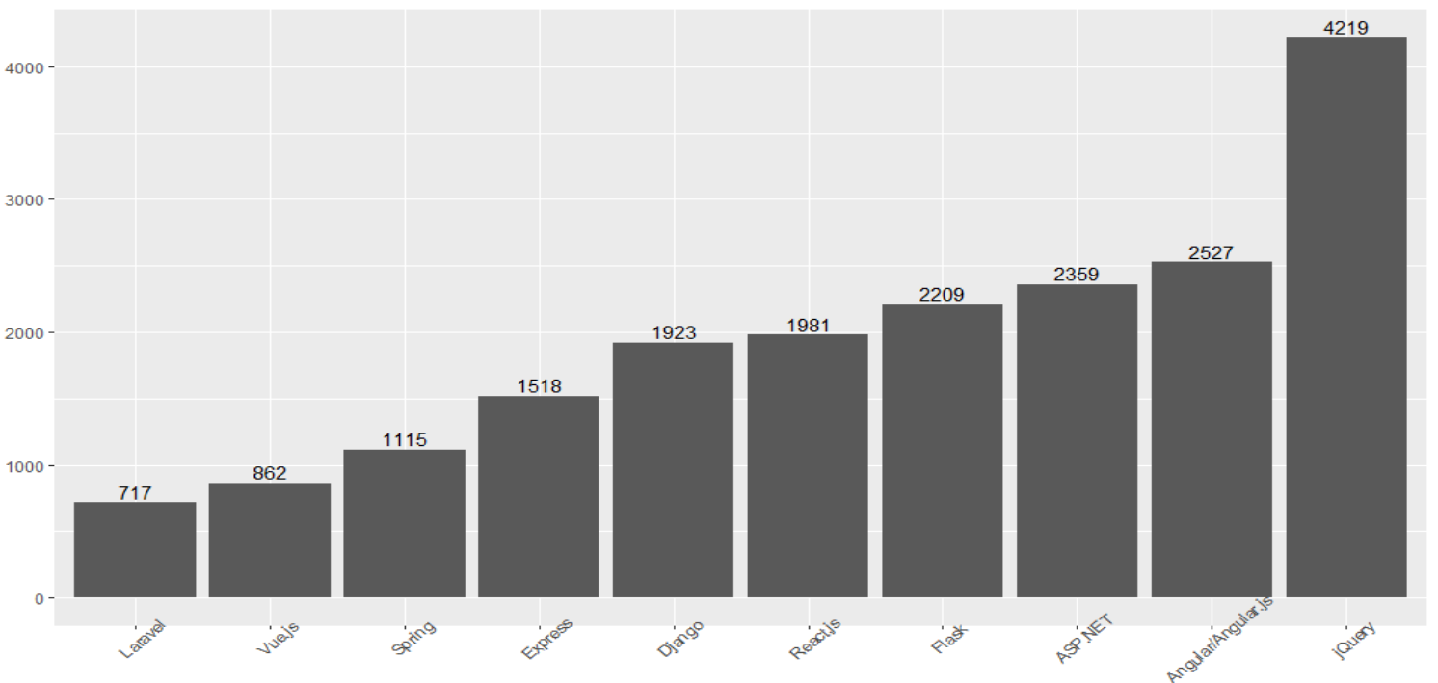
Web Frames
Most Commonly Used Web Frames

Slide 12
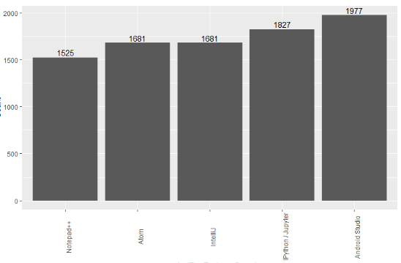
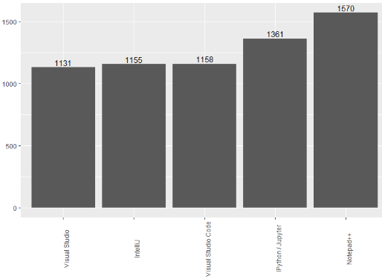
Development Environments
First Choice Environment
Second Choice Environment
Note: RStudio was the 12th most popular environment overall

Slide 13
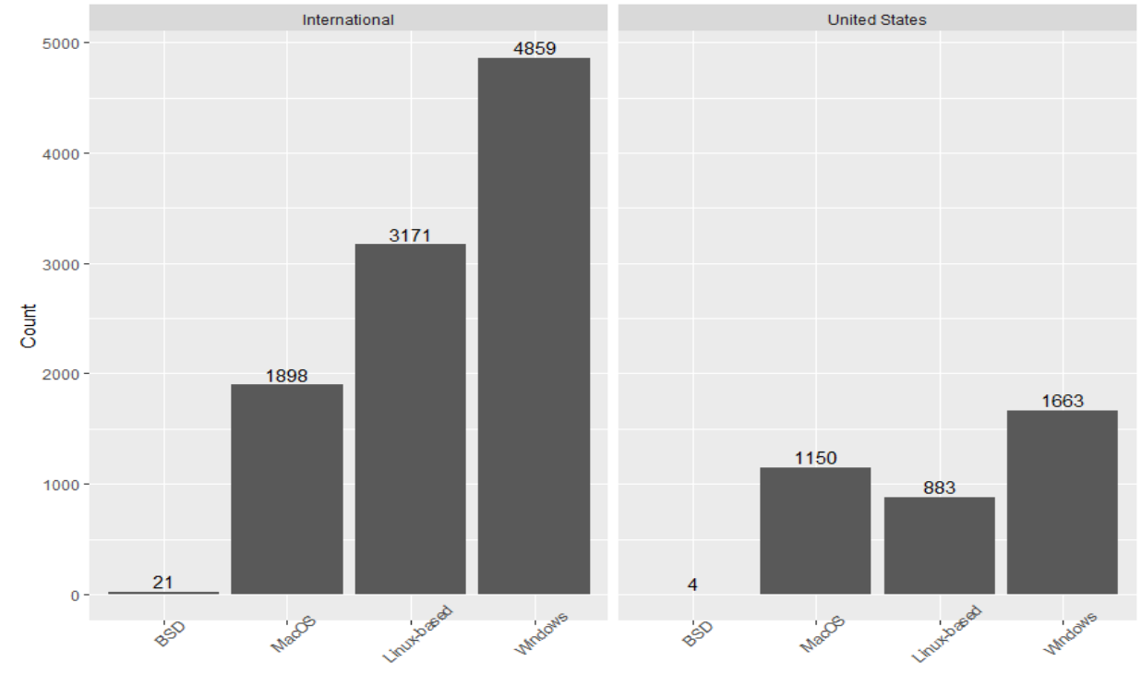
Operating Systems
Operating Systems USA vs. International

Slide 14
Conclusions
Demographics – US response is 3 times next country (India)
No regional differences with respect to job satisfaction
SQL popular overall for both language and database
Platforms – Linux or Windows, runner up Android
Web frames, dev. environments, OS – no surprises
For Further Research:
Pinpoint any patterns in tech preference
Validate the definition of 'data scientist'
Incorporate statistical inference techniques
U.S. patterns – request state data from Stack Overflow

